Slide 1
Jabar Coding Camp
Intro to Docker

Slide 2
Salam kenal!
Halo teman-teman Jabar Coding Camp,
Perkenalkan nama saya Azinudin Achzab biasa dipanggil azin / udin.
Saat ini saya bekerja di Virgo Indonesia sebagai Backend Engineer.

Slide 3






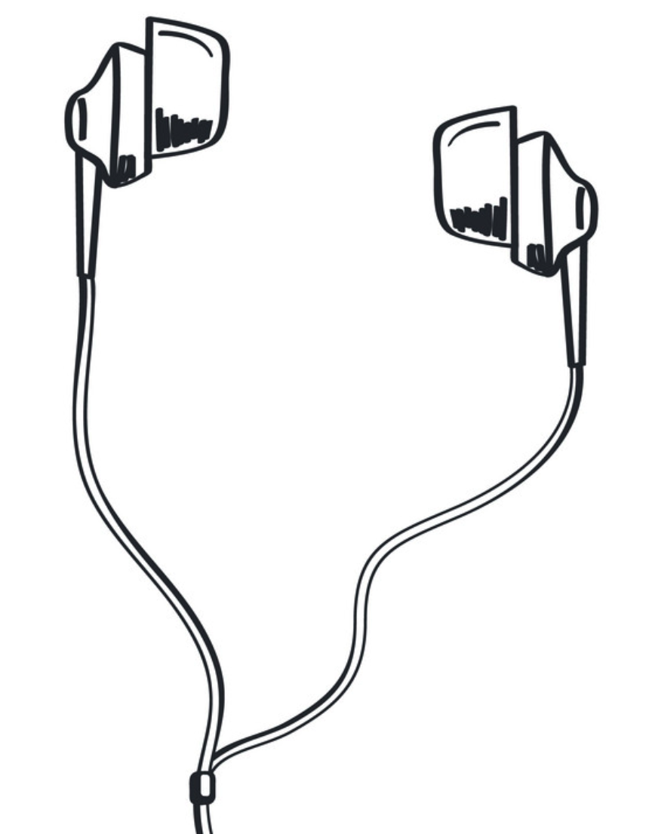

Jangan lupa rulesnya guys!
Join online class in time
Make sure the internet network is stable
Always turn on the webcam during class
Mute microphones when facilitator explain, except Q&A
Recording class is prohibited
Click the “raise hand” button when asking
Using earphones are highly recommended
Break time (15-20 min for 1 Forum Discussion)
BINAR ACADEMY
BINAR ACADEMY

Slide 4

Berdoa dulu yuk!

Slide 5
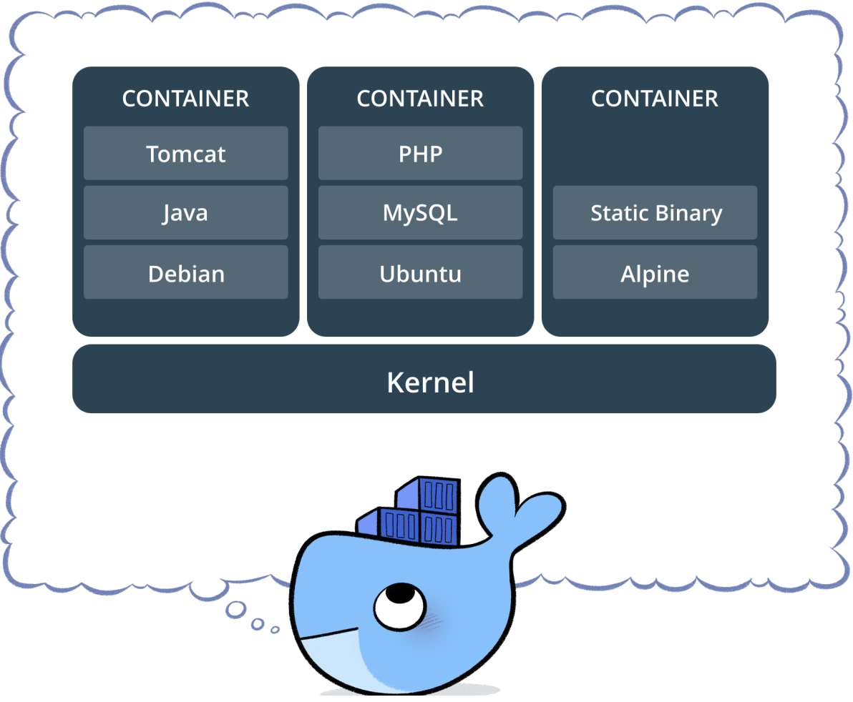
Container and Docker
Apa itu container?
a lightweight, stand-alone, executable package of a piece of software that includes everything needed to run it: code, runtime, system tools, system libraries, settings.
Apa itu docker?
Docker adalah salah satu tools/ framework untuk mengimplementasikan sistem container.
Beberapa alternatif docker: podman, containerd, dll
Notes:
Review tugas kemarin dlu, ingatkan untuk yg belum

Slide 6
Container and Docker
Notes:
Review tugas kemarin dlu, ingatkan untuk yg belum

Slide 7
Container and Docker
Kenapa harus container?
Containers running on a single machine share that machine's operatng system kernel; they start instantly and use less compute and RAM.
Images are constructed from flesystem layers and share common fles. his minimizes disk usage and image downloads are much faster.
Containers are based on open standards and run on all major Linux distributons, Microsof Windows, and on any infrastructure including VMs, bare-metal and in the cloud.
Docker containers isolate applicatons from one another and from the underlying infrastructure. Docker provides the strongest default isolaton to limit app issues to a single container instead of the entre machine.
Notes:
Review tugas kemarin dlu, ingatkan untuk yg belum

Slide 8
Container and Docker
Bagaimana docker bekerja?
Docker bekerja dengan mengisolasi environment pengguna dengan menciptakan docker images / Cetak biru / Blueprint yang dapat digunakan, dibagikan dan dimodifikasi kembali.
Docker mengisi proses deployment pada SDLC sehingga programmer / developer dan devops / server administrator mendapatkan kemudahan Dalam mencapai tahap deployment yang mudah dan ideal
Notes:
Review tugas kemarin dlu, ingatkan untuk yg belum

Slide 9
Container and Docker
Notes:
Review tugas kemarin dlu, ingatkan untuk yg belum

Slide 10
Instalasi Docker
https://docs.docker.com/get-docker/

Slide 11

Mari kita mulai Coding!

Slide 12
Useful Notes
Go mod init
Go mod download
package main
import "github.com/gin-gonic/gin"
func main() {
r := gin.Default()
r.GET("/ping", func(c *gin.Context) {
c.JSON(200, gin.H{
"message": "pong",
})
})
r.Run() // listen and serve on 0.0.0.0:8080 (for windows "localhost:8080")
}
FROM golang:1.17-alpine
WORKDIR /app
COPY . ./
RUN go mod download
RUN go build -o /go-test
EXPOSE 8080
CMD [ "/go-test" ]
docker build -t go-test .
docker run -d -p 8080:8080 --name=go-test go-test
Notes:
Review tugas kemarin dlu, ingatkan untuk yg belum

Slide 13
Useful Notes
docker network list
docker network create belajar
docker network remove belajar
docker build -t pgsql-test -f Dockerfile-db .
docker run -d --net belajar -p 5432:5432 —-name pg-belajar pgsql-test -v /var/run/postgresql:/var/run/postgresql
docker ps
docker inspect container_id | grep IPAddress
Copy to app
docker build -t go-test .
docker run -d --net belajar -p 8080:8080 --name go-belajar go-test
docker ps
docker logs container_id
=======================================================================
docker-compose up -d —-build
Notes:
Review tugas kemarin dlu, ingatkan untuk yg belum

Slide 14

Let’s Wrap Up!

Slide 15
Any Questions?
https://t.me/eskadia

Slide 16
THANK
YOU

